Slide 1
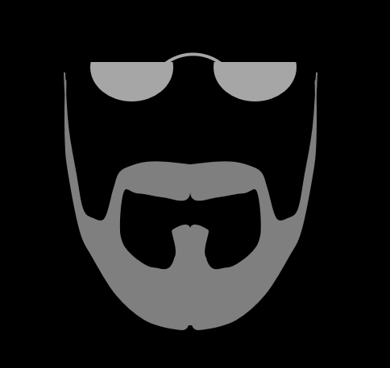
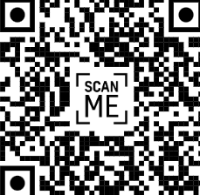
THE GRAY BEARD BAND
Mix of hits from the 90s, 80s, 70s, & 60s with a few oldies, blues, country, & originals
Indoor/Outdoor Venues Public/Private Events
f @thegraybeardbandakron
YouTube Promo “thegraybeardbandakron”
graybeardbandakron@gmail.com
Text or Call 330.396.0059
Shrink to 27% to get a view

